Slide 1
MOD007996
Big Data Analytics
Week 05

Slide 2
Mongo Query Structure
db.mycol.aggregate(
[{$group :
{_id : "$field",
newId : {$avg : "$fieldAveraged"},
newIdToo : {$avg : "$fieldAveraged"}, ...
}
}]
)

Slide 3
Explanation
[{$group : {...}}]: This is the first stage of the aggregation pipeline. It uses the $group operator to group documents from the collection based on a specified field, which is represented by _id.
"_id": "$field": This part of the query groups documents by the value of the field field. In other words, it groups together all documents that have the same value in the field field.
Inside the $group stage, you have two additional fields:
newId: This field is calculated using the $avg operator. It calculates the average value of the fieldAveraged field for all documents within each group created by _id.
newIdToo: Similarly, this field is calculated using the $avg operator and computes the average value of the fieldAveraged field for each group.

Slide 4
In Compass
{_id : "$field",
newId : {$avg : "$fieldAveraged"},
newIdToo : {$avg : "$fieldAveraged"}, ...
}

Slide 5
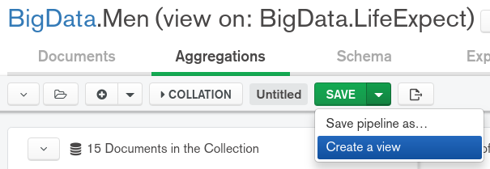
Creating a View

Slide 6
Example Aggregate Query
db.mycol.aggregate(
[{$group: {
_id: "$Band",
avMatB: {$avg: "$MatB"},
avFatB:{$avg: "$FatB"}
}}]
)

